Slide 1

Image Analysis Features in ZEN Blue
APAC Digital Solutions
2021-01-11

Slide 2
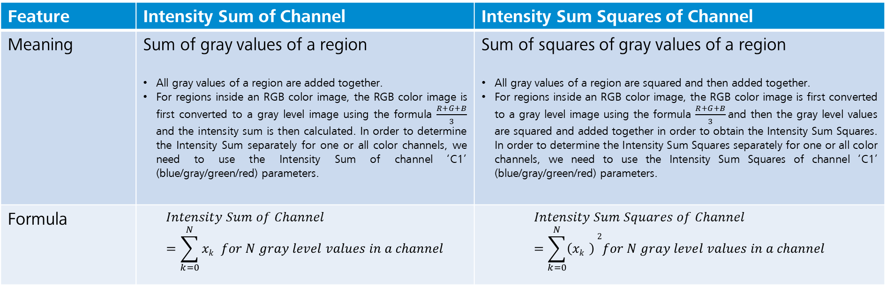
Intensity Sum of Channel Vs Intensity Sum Squares of Channel
Feature | Intensity Sum of Channel | Intensity Sum Squares of Channel
Meaning | Sum of gray values of a region All gray values of a region are added together. For regions inside an RGB color image, the RGB color image is first converted to a gray level image using the formula $\frac{R+G+B}{3}$ and the intensity sum is then calculated. In order to determine the Intensity Sum separately for one or all color channels, we need to use the Intensity Sum of channel ‘C1’ (blue/gray/green/red) parameters. | Sum of squares of gray values of a region All gray values of a region are squared and then added together. For regions inside an RGB color image, the RGB color image is first converted to a gray level image using the formula $\frac{R+G+B}{3}$and then the gray level values are squared and added together in order to obtain the Intensity Sum Squares. In order to determine the Intensity Sum Squares separately for one or all color channels, we need to use the Intensity Sum Squares of channel ‘C1’ (blue/gray/green/red) parameters.
Formula | $$Intensity Sum of Channel=\sum_{k=0}^{N}{xk }for N gray level values in a channel$$ | $$Intensity Sum Squares of Channel=\sum_{k=0}^{N}{\left(xk \right)}2for N gray level values in a channel$$
The difference between the Intensity Sum of Channel and the Intensity Sum Squares of Channel is that the former is the sum of gray levels of the channel whereas the latter is the sum of squares of gray levels of the channel.

Slide 3
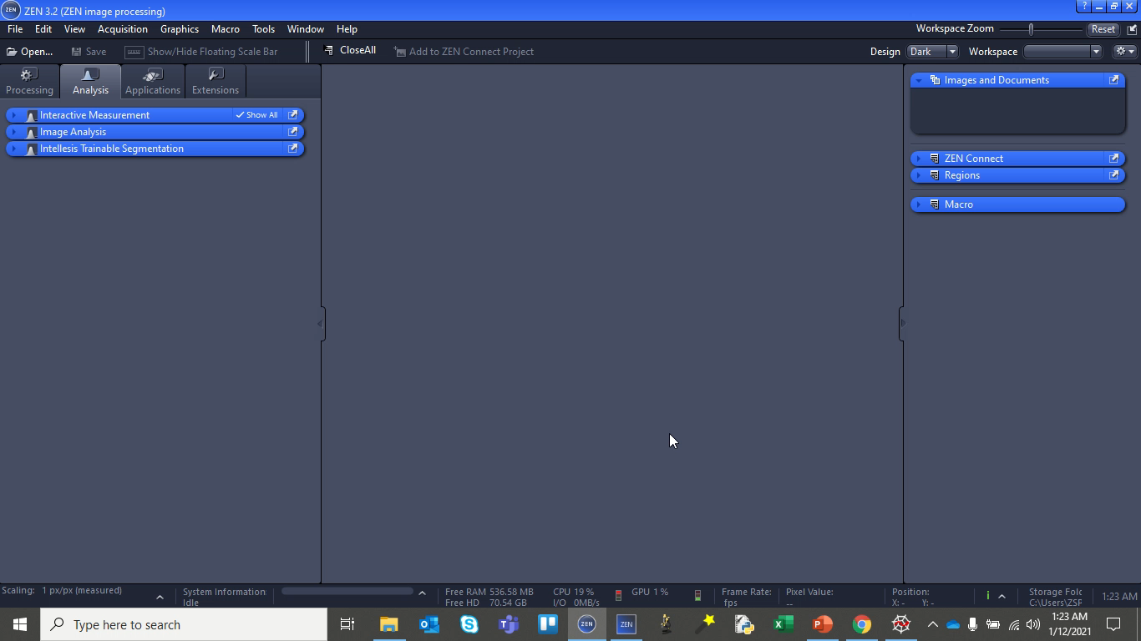
An Image Analysis Video Demo
Note that the Input Image (testImage.jpg) used in this example is synthesized using a Python script for better understanding and explanation of the Image Analysis features.

Slide 4
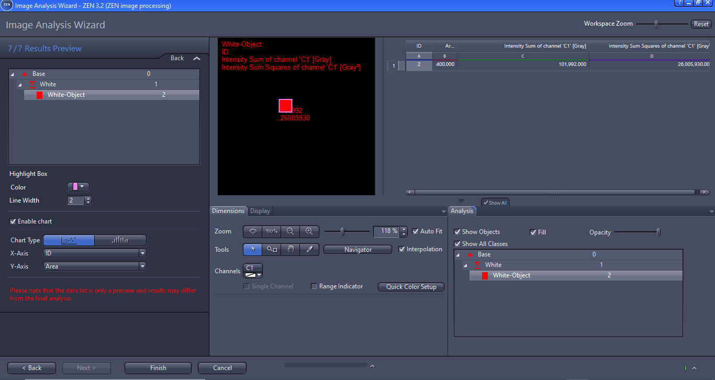
An Image Analysis Results
The Image Analysis features – Intensity Sum of Channel and Intensity Sum Squares of Channel are obtained using ZEN Blue Image Analysis Module. The corresponding values for this example (testImage.jpg) is 101992.000 and 26005930.000 respectively

Slide 5
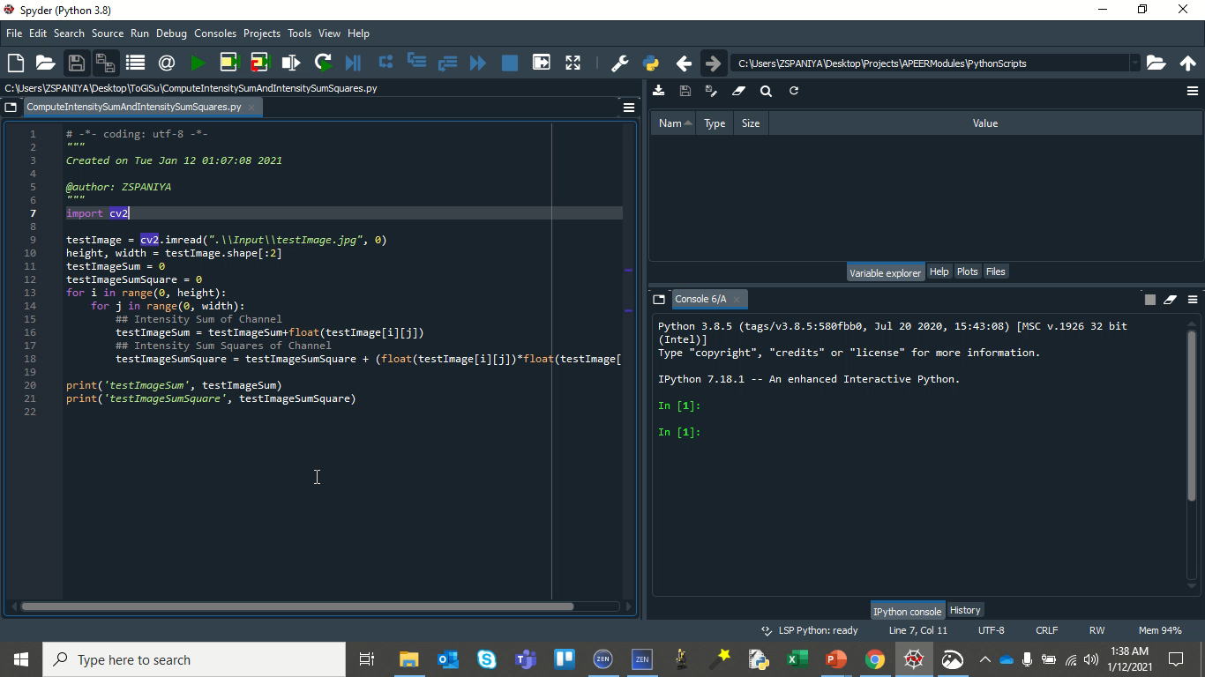
Computation of Image Features using a Python Script
The Image Analysis features – Intensity Sum of Channel and Intensity Sum Squares of Channel are also computed using a Python script. The values obtained are 102012.0 and 26005956.0 respectively. These values match with the ones obtained from ZEN Blue Image Analysis.
Hence, we can confirm that Intensity Sum of Channel means the sum of gray levels of the channel and Intensity Sum Squares of Channel means sum of squares of gray levels of the channel.

